Slide 1
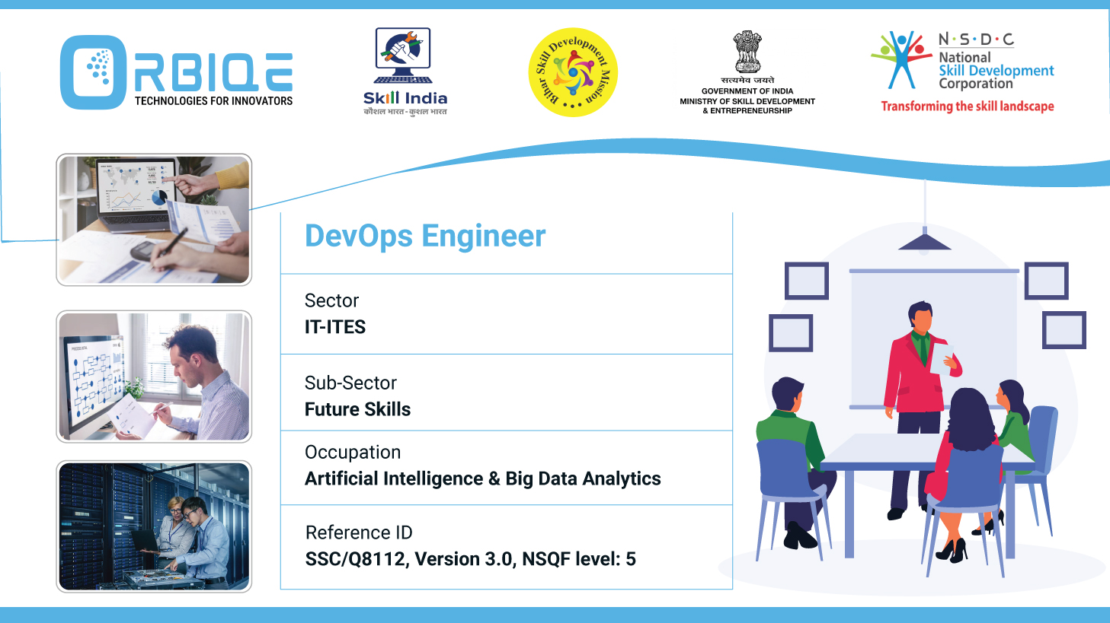
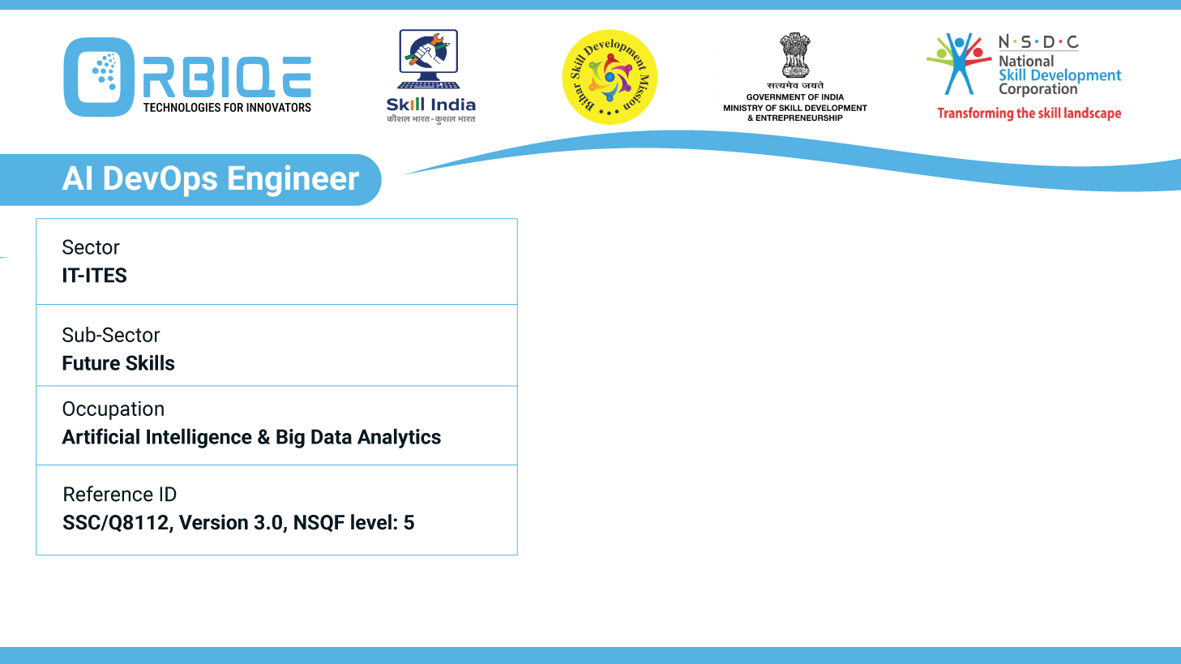
Name- Krishna Kant Dubey

Slide 2

AI and Big Data in Industry

Slide 3
Agenda
Explore and articulate the diverse applications of AI and Big Data across different industries
Providing insights into how these technologies address industry specific challenges and drive innovation

Slide 4
Explore and articulate the diverse applications of AI and Big Data across different industries

Slide 5
Providing insights into how these technologies address industry specific challenges and drive innovation

Slide 6
Thank You

